Slide 1
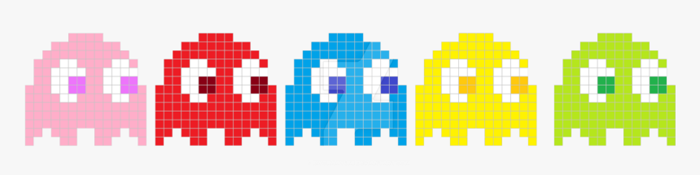
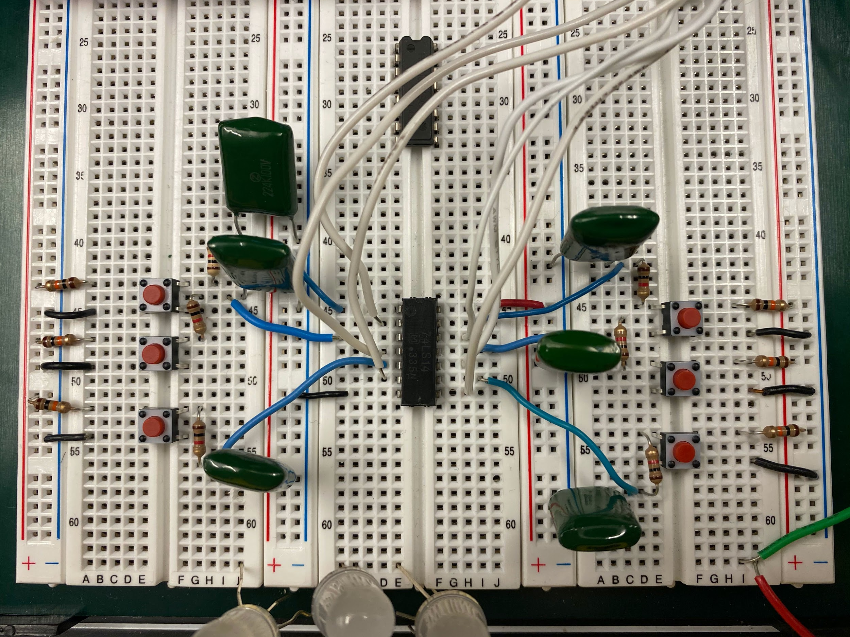
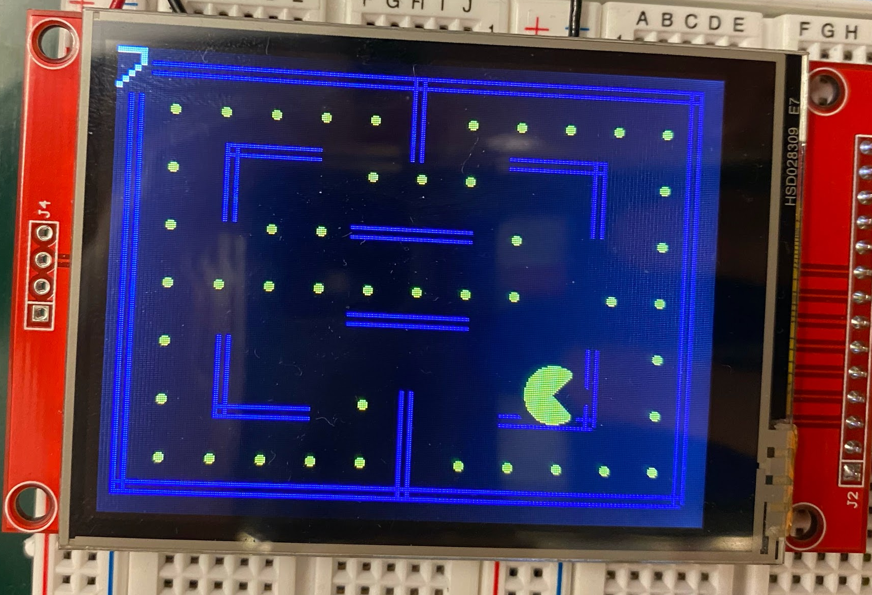
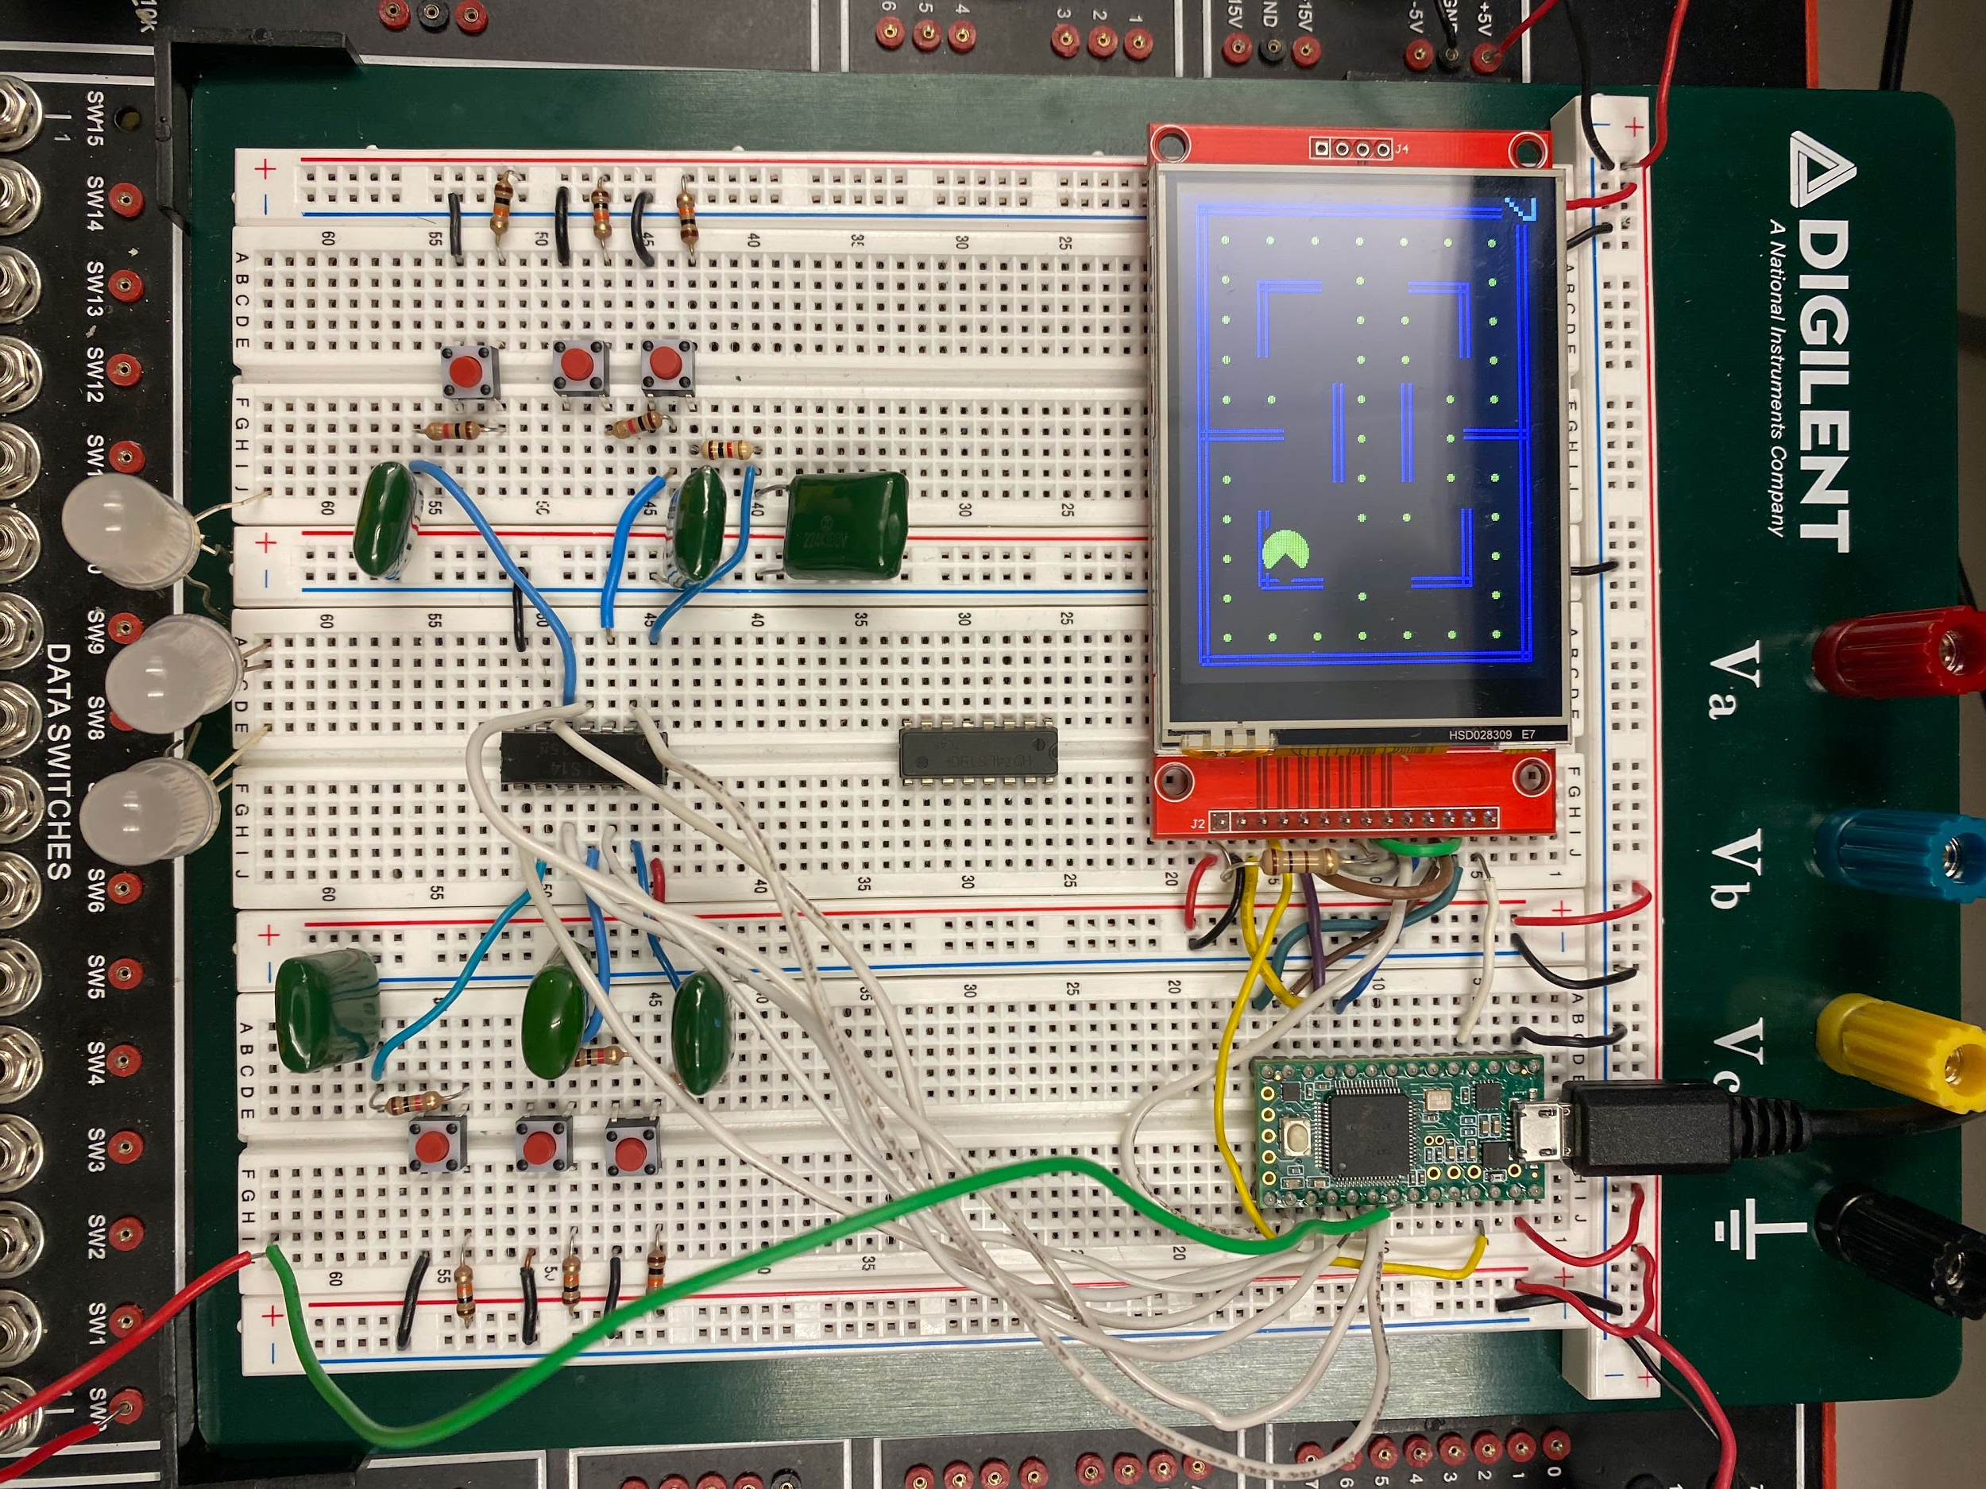
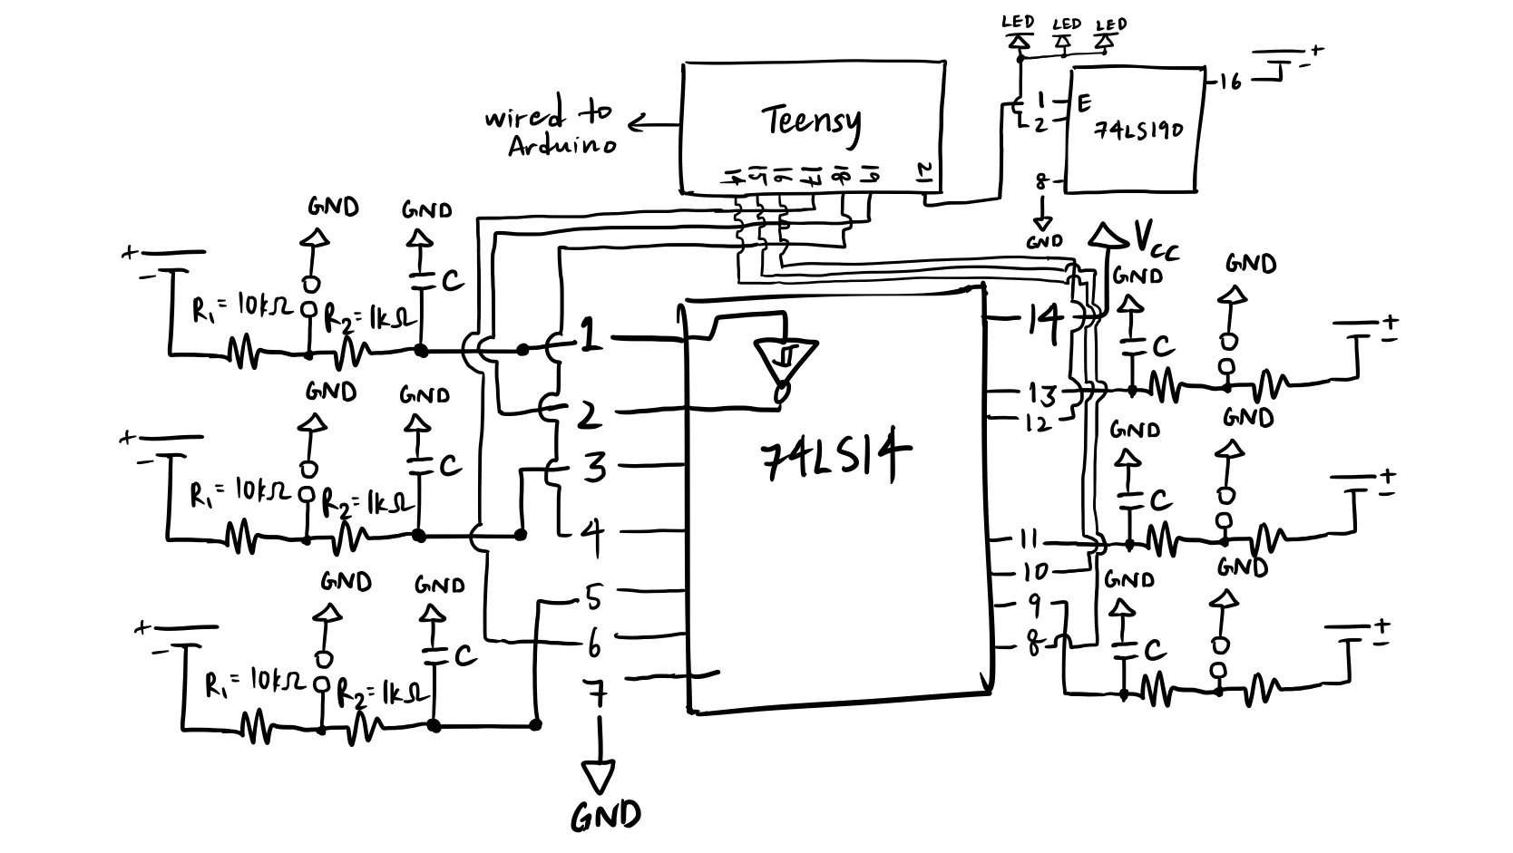
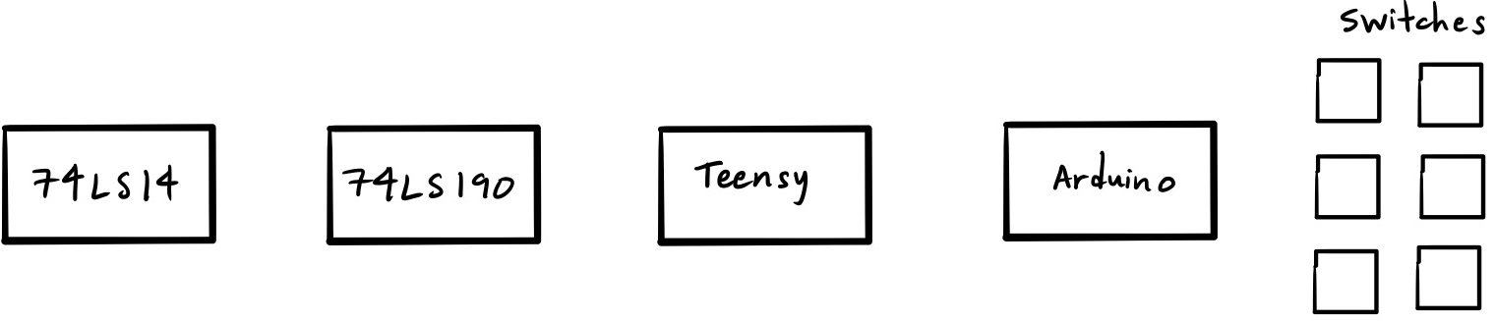

OK NINTENDO
The OK Nintendo is a multi-game, simple arcade machine, with PAC-MAN, SUPER SEGALL BROS, and POKEMON HO.
GAME 1: PAC-MAN (POSTER DEMO)
INSTRUCTIONS: Move PAC-MAN UP, DOWN, LEFT, or RIGHT within the bounds of a 2D map. Collide with PELLETS to consume them. Avoid GHOSTS, which follow a
random path.
OBJECTIVE: Clear all PELLETS from the screen within 3 tries.
CIRCUIT:
Circuit Elements: Button (6), Capacitor (6), Resistor (12), Debouncer, Teensy, Arduino, 74LS190 Counter, LED (3)
Button Functions: UP, DOWN, LEFT, RIGHT, RESET, PAUSE.
RESET: Sets all DEATHS to zero.
PAUSE: Latches location of all GHOSTS, as well as PAC-MAN.
Circuitry:
Each button is debounced using a 220 nF Mylar capacitor, 1 kΩ resistor connected to 5V power, and 10 kΩ resistor connected to the debouncer.
Debouncer outputs are connected to a Teensy board, wired to an Arduino Touch Screen.
Output of Teensy is a count, which increases by 1 after every collision with a GHOST.
Teensy count output sends pulse to a 74LS190 Counter, which is then sent to a series of 3 activated LED lights, which represent remaining lives.
After each DEATH, LIVES score decreases by 1, and 1 LED light is turned off for the remainder of the game.
PAC-MAN death animation runs, and PAC-MAN location is reset.
ARDUINO CODE DETAILS:
Setup: LIVES (Number of LIVES remaining), and SCORE (Scored based on number of PELLETS consumed) displayed at all times.
Movement: After one press and release of a movement button, PAC-MAN will continue in the respective direction until collision with either a WALL or GHOST, or
after receiving a new direction command.
Collision Detection:
Collision with a PELLET: PELLET disappears, SCORE increases by 1.
Collision with a WALL: Prevention of further movement of PAC-MAN in that direction.
Collision with a GHOST: DEATH score increases by 1, 1 LED turns off, PAC-MAN death animation runs, location of PAC-MAN is reset.
Circuit Diagram Map Breadboard
Animation: 1. PAC-MAN movement animation: PAC-MAN opens and closes “mouth” continuously, in the direction of movement.
2. Upon DEATH, PAC-MAN disappears.
Equipment:
GOOD LUCK AND HAVE FUN!
ss
Image: Debouncer diagram for 6 buttons, with outputs going to Teensy inputs.
Mae Martel and Leo Ascenzi
Electronics (PHYS 336)
Segall
Spring 2020

